Slide 1
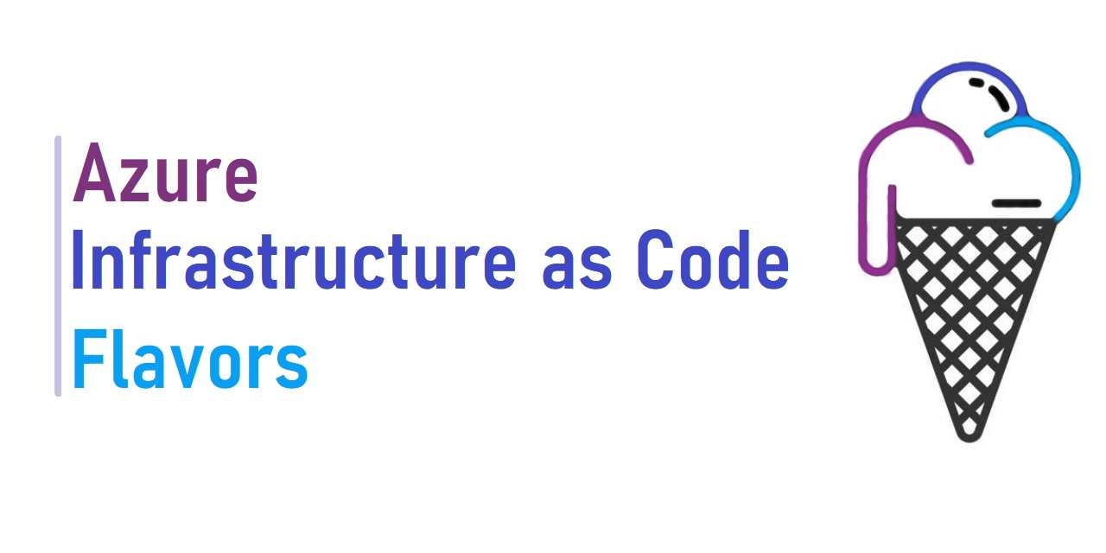

John Folberth
Senior Cloud Solutions Architect – Engineering
Microsoft
Health and Life Sciences
https://aka.ms/HeartlandDev22

Slide 2
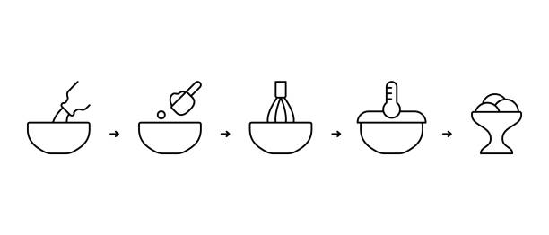
Audience
https://aka.ms/HeartlandDev22
Anyone new to Infrastructure as Code (IaC)
Those experienced in one language of IaC and want to learn more
Curious to learn something new
Interested to see how IaC Resources can be deployed

Slide 3









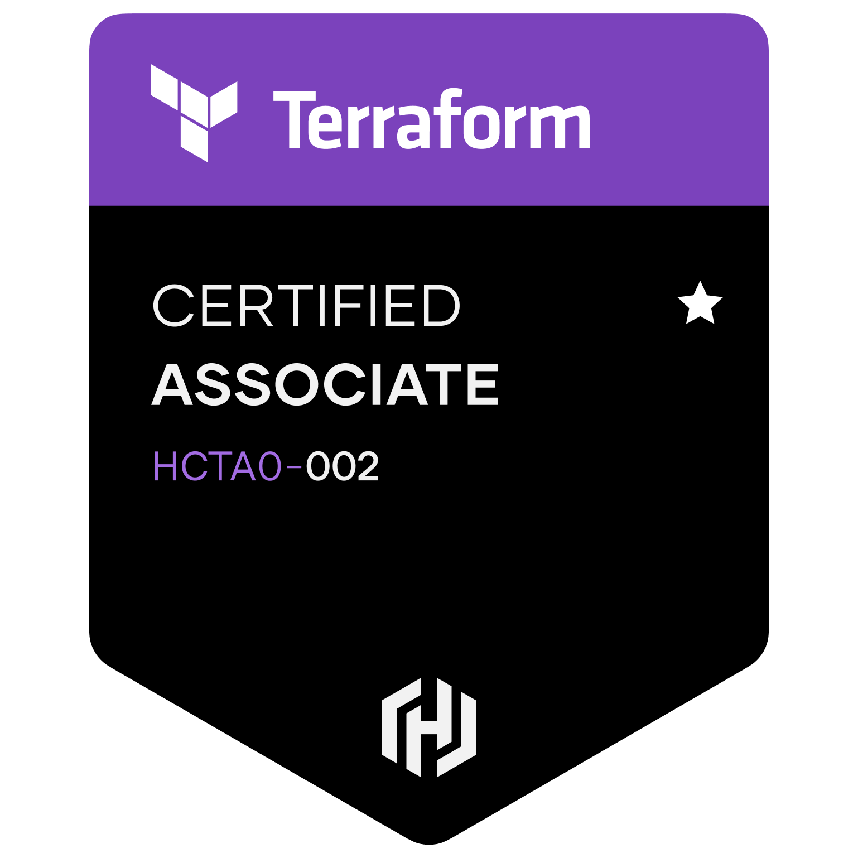

John Folberth
https://aka.ms/HeartlandDev22
John-Folberth
JFolberth
j_Folberth
Based out of Grand Rapids, MI
Former Azure MVP
Microsoft Certified Trainer (MCT)
DevOps Advocate
Peer reviewer on “Building Application with Azure Resource Manager: Leverage IaC to Vastly Improve the Life Cycle of your Applications”
Spoken at various User Groups and Conferences on topics ranging from Infrastructure as Code, DevOps YAML Pipelines, and modern Data Analytics Platforms
Experience as Lead DevOps engineer on multiple accounts

Slide 4

Agenda
https://aka.ms/HeartlandDev22
Introduction
What is Infrastructure As Code (IaC)?
Benefits
Best Practices
Flavors of IaC
Bicep
ARM
Terraform
Pulumi

Slide 5

Everyone Has a Favorite Ice Cream….
What about allergies?
Regional Flavors?

Slide 6

Key Terminology & Requirements
https://aka.ms/HeartlandDev22
Terminology | Definition
State File | File containing Azure Resource definitions
Parameters/Variables | Input passed into the IaC being executed
Day 0 Support | Ability to support new features on Day 1 as well as preview or private features
Provider | Libraries created by different vendors.(Azure, AWS, GCP, Azure Active Directory, etc)
Modules | Separate file container resource(s) definitions which can be reused
Registry | Modules are hosted in a centralized location
Requirements:
Azure Subscription
Minimum Contributor Access
Appropriate Tooling

Slide 7

But First….Let’s Review Benefits IaC
https://aka.ms/HeartlandDev22
Reduce Risk of Human Error
Agility
Integration with Software Delivery Lifecycle (SDLC)
Reusability
Enhanced Security
Foundational for DevOps

Slide 8

Best Practices
https://aka.ms/HeartlandDev22
IaC code is stored together with application code
Faster Development Time
Adhere to same Software Delivery Lifecycle
Deployed together to prevent drift/staleness
Code is redeployable
Easily readable
Independent Reusable Modules
All Key values are parameters/variables
Insert into any project
No secrets in codebase
Separate input file per environment
Ideally eliminate manual intervention

Slide 9
Agenda
https://aka.ms/HeartlandDev22
Introduction
What is Infrastructure As Code (IaC)?
Benefits
Best Practices
Flavors of IaC
Bicep
ARM
Terraform
Pulumi

Slide 10

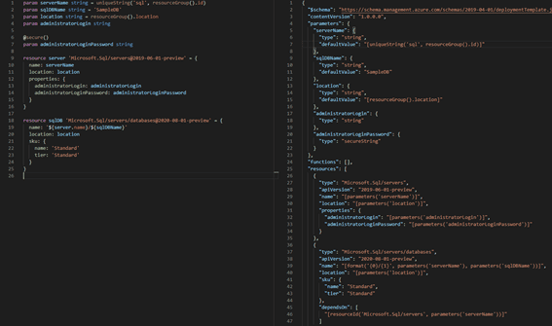
Azure Bicep
Domain Specific Language (DSL)
No State File
Transpiles to ARM template
Released monthly
Day 0 Support
Azure only
Registry Support
First Production release v 3.1 in March 2021
https://aka.ms/HeartlandDev22

Slide 11
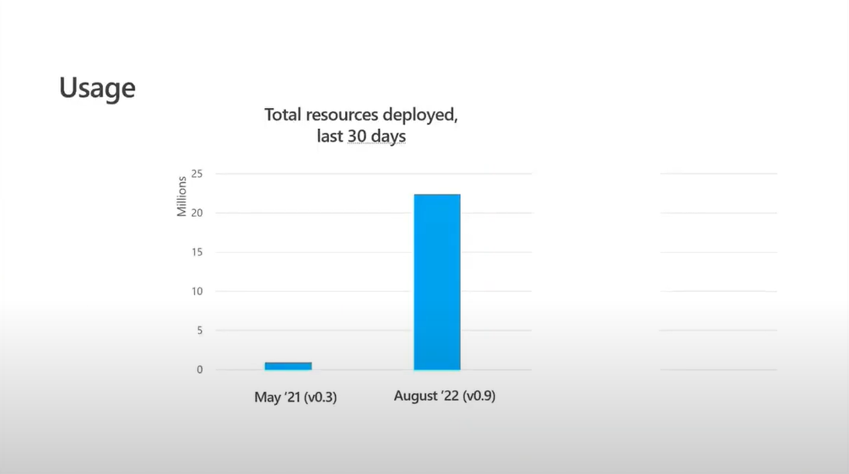
Azure Bicep
Resource Creates and updates
Shared August Bicep Community Call
May `21
< 1 Million
August `22
> 11 Million
https://aka.ms/HeartlandDev22

Slide 12

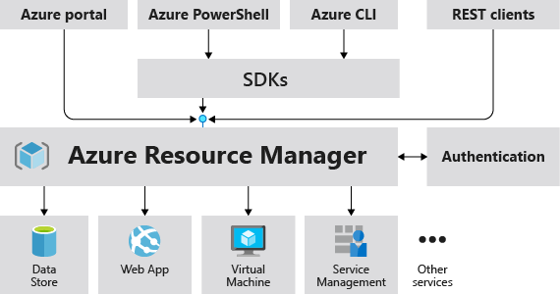
Azure Resource Manager Template (ARM)
JSON File Format
Explicitly track dependencies
Export from Azure
Day 0 Support
Azure specific
No state file
Native Tool
https://aka.ms/HeartlandDev22

Slide 13

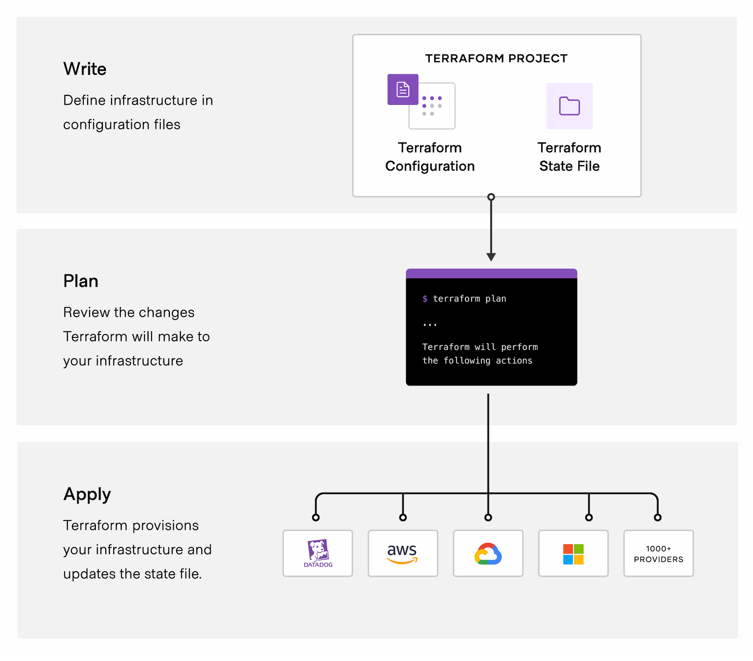
Hashicorp Terraform
Requires a state file
Providers open sourced
Terraform HCL is cloud agnostic, providers aren’t
Secrets stored in the state file as plain text
Managing/tracking provider and Terraform versions
Multiple cloud and non cloud providers available
Best practice use lower case and `_` in place of spaces
Support varies by provider/resource type
More detailed information on changes
https://aka.ms/HeartlandDev22

Slide 14

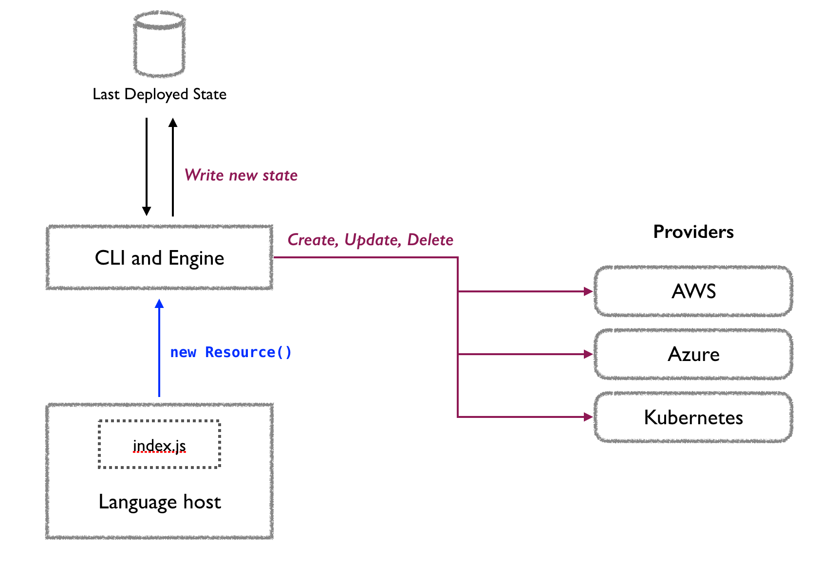
Pulumi
Can use native code formatters
Typescript
YAML
Go
C#
Python
Java
Manage remote resource definition via Pulumi Service
"Modules" are defined and hosted in npm packages
Still considered the "new kid" on the block
Open source
Spaghetti Code Risk
https://aka.ms/HeartlandDev22

Slide 15
Key Terminology & Requirements
https://aka.ms/HeartlandDev22
Feature | ARM | Bicep | Terraform | Pulumi
State File | Q | Q | R | R
Parameters/Variables | R | R | R | R
Day 0 Support | R | R | Q | Q
Providers | Q | Q | R | R
Modules | Q | R | R | Q
Registry | Q | R | R | Q
Multi Cloud | Q | Q | R | R
On Prem | Q | Q | R | R
Multi Language Support | Q | Q | Q | R

Slide 16
Everyone Has a Favorite Ice Cream….
Questions/Comments/Conundrums
FEEDBACK, FEEDBACK, FEEDBACK

Slide 17





John Folberth
https://aka.ms/HeartlandDev22
John-Folberth
JFolberth
j_Folberth
Based out of Grand Rapids, MI
Former Azure MVP
Microsoft Certified Trainer (MCT)
DevOps Advocate
Peer reviewer on “Building Application with Azure Resource Manager: Leverage IaC to Vastly Improve the Life Cycle of your Applications”
Spoken at various User Groups and Conferences on topics ranging from Infrastructure as Code, DevOps YAML Pipelines, and modern Data Analytics Platforms
Experience as Lead DevOps engineer on multiple accounts

